Slide 1

Learning Objective
I will use factor trees to find prime factors.
Enter quietly, please be ready with the following on your desk:
Whiteboard
Whiteboard marker
Exercise Book
Pencil, pen, ruler and red pen
Diary
Calculator
Device – charged or borrowed from Library before maths

Slide 2
Daily Review
CFU
How many answers will you get for LCM?
The Lowest Common Multiple (LCM) of two numbers is the lowest number that appears in all of the numbers’ times tables.
LCM of 2 and 5
LCM of 3 and 6
Write out the times tables of the first number.
2
4
6
8
10
5
10
3
6
6
Write out the times tables of the second number.
Highlight the first common number between the lists.
The LCM of 2 and 5 is 10.
The LCM of 3 and 6 is 6.
Clearly write out your answer.

Slide 3
Daily Review
CFU
Why is 1 always a common factor?
Just like common multiples, a common factor divides exactly into two or more numbers.
HCF of 30 and 40
HCF of 12 and 10
Write out the factors of the first number.
1
2
3
5
6
10
15
30
1
2
4
5
8
10
20
40
1
2
3
4
6
12
1
2
5
10
Write out the factors of the second number.
Highlight the common numbers between the lists.
The HCF of 12 and 10 is 2.
Clearly write out your answer.
The HCF of 25 and 40 is 5.

Slide 4
Skill Development
CFU 1
CFU 2
How do you decide if a number is prime?
How do you decide if a number is composite?
To find if a number is composite or prime:
40
41
Write out the factors of the number.
1, 2, 4, 5, 8, 10, 20, 40
1, 41
There are 8 factors,
There are 2 factors,
therefore 40 is a composite number.
therefore 41 is a prime number.
Count how many factors there are.
2 Factors = Prime
>2 Factors = Composite
42
43
1, 2, 3, 6, 7, 14, 21, 42
1, 43
There are 8 factors,
There are 2 factors,
therefore 42 is a composite number.
therefore 43 is a prime number.

Slide 5
Question
Which of the following are prime numbers?
A: 15
B: 27
C: 31
D: 42
E: 63
F: 85

Slide 6
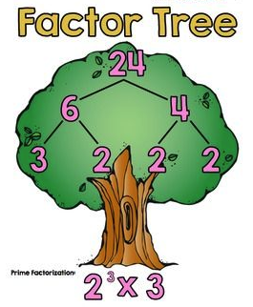
Learning Objective
CFU
What will we learn today?
CFU
I will use factor trees to find prime factors.
How will you know that you are successful?
Success Criteria
At the end of the lesson, I will be able to:
Use a factor tree to identify prime factors of a number.
Use a factor tree to determine the HCF and LCM of a pair of numbers.

Slide 7
Activate Prior Knowledge
CFU
Why do we use index notation?
Index notation – to save space when repeating a number multiplied by itself, mathematicians write in index form.
5
INDEX or POWER
4
BASE
4⁵ = 4 x 4 x 4 x 4 x 4 = 1,024
Index Form
Expanded Form
Answer

Slide 8
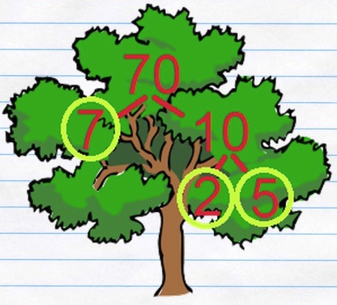
Concept Development
CFU
What are factor trees used for?
Factor Trees are a useful way of finding the prime factors of a number.
CFU
Why are factor trees called ‘trees’?
They are called ‘trees’ because they ‘branch out’ from the original number.
However, they are more like upside-down trees, because they branch down, not up.

Slide 9

Skill Development
HINT
Use the divisibility laws and count your way up.
e.g. Is it divisible by 2? By 3? By 4?…
To create a factor tree:
18
Start with the original number at the top of the page.
Draw two ‘branches’ down the page.
Write any factor pair at the end of the branches.
Circle any prime numbers.
3
6
Draw more branches for composite numbers.
Write down your factors.
2
3
Circle any prime numbers.
18 = 3 x 3 x 2 = 3² x 2

Slide 10
Skill Development
HINT
Use the divisibility laws and count your way up.
e.g. Is it divisible by 2? By 3? By 4?…
To create a factor tree:
Whiteboards
20
Start with the original number at the top of the page.
Draw two ‘branches’ down the page.
Write any factor pair at the end of the branches.
Circle any prime numbers.
5
4
Draw more branches for composite numbers.
Write down your factors.
2
2
Circle any prime numbers.
20 =
5 x 2 x 2 = 5 x 2²

Slide 11
Skill Development
HINT
Use the divisibility laws and count your way up.
e.g. Is it divisible by 2? By 3? By 4?…
There are often many different ways to draw a factor tree of the same number.
24
24
24
12
2
4
6
3
8
2
3
6
2
2
2
2
4
24 = 2³ x 3
3
2
2
2

Slide 12
Guided Practice
HINT
Use the divisibility laws and count your way up.
e.g. Is it divisible by 2? By 3? By 4?…
Whiteboards
Draw factor trees of the following numbers.
16
20
32

Slide 13
Skill Development
HINT
Use the divisibility laws and count your way up.
e.g. Is it divisible by 2? By 3? By 4?…
To find the HCF and LCM using factor trees:
Draw a factor tree of both numbers.
20
20 = 2 x 2 x 5
Write the numbers in expanded form.
32
32 = 2 x 2 x 2 x 2 x 2
Highlight the common numbers in the first list.
HCF of 20 and 32
= 2 x 2
= 4
Multiply the highlighted numbers to find the HCF.
LCM of 20 and 32
= 5 x 32
Multiply the second number with the leftover numbers from the first to find the LCM.
= 160

Slide 14
Skill Development
HINT
Use the divisibility laws and count your way up.
e.g. Is it divisible by 2? By 3? By 4?…
To find the HCF and LCM using factor trees:
Draw a factor tree of both numbers.
50
50 = 2 x 5 x 5
Write the numbers in expanded form.
75
75 = 3 x 5 x 5
Highlight the common numbers in the first list.
HCF of 50 and 75
= 5 x 5
= 25
Multiply the highlighted numbers to find the HCF.
LCM of 50 and 75
= 2 x 75
Multiply the second number with the leftover numbers from the first to find the LCM.
= 150

Slide 15
Skill Development
CFU 2
CFU 1
How do we find the LCM using this method? (Step 4)
How do we find the HCF using this method? (Step 3)
To find the HCF and LCM using factor trees:
Draw a factor tree of both numbers.
100
100 = 2 x 2 x 5 x 5
Write the numbers in expanded form.
150
150 = 2 x 3 x 5 x 5
Whiteboards
Highlight the common numbers in the first list.
Multiply the highlighted numbers to find the HCF.
Multiply the second number with the leftover numbers from the first to find the LCM.

Slide 16
Skill Development
CFU 2
CFU 1
How do we find the LCM using this method? (Step 4)
How do we find the HCF using this method? (Step 3)
To find the HCF and LCM using factor trees:
Draw a factor tree of both numbers.
84
84 = 2 x 2 x 3 x 7
Write the numbers in expanded form.
96
96 = 2 x 2 x 2 x 2 x 2 x 3
Highlight the common numbers in the first list.
Whiteboards
Multiply the highlighted numbers to find the HCF.
Multiply the second number with the leftover numbers from the first to find the LCM.

Slide 17
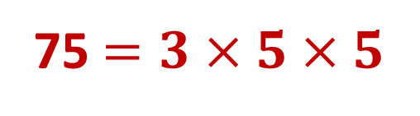

Guided Practice
CFU 2
CFU 1
How do we find the LCM using this method? (Step 4)
How do we find the HCF using this method? (Step 3)
To find the HCF and LCM using factor trees:
Whiteboards
Draw a factor tree of both numbers.
25 and 75
Write the numbers in expanded form.
25 $=5×5$
75 $=3×5×5$
Highlight the common numbers in the first list.
Multiply the highlighted numbers to find the HCF.
Multiply the second number with the leftover numbers from the first to find the LCM.

Slide 18


Guided Practice
CFU 2
CFU 1
How do we find the LCM using this method? (Step 4)
How do we find the HCF using this method? (Step 3)
To find the HCF and LCM using factor trees:
Whiteboards
Draw a factor tree of both numbers.
35 and 90
Write the numbers in expanded form.
35 $=5×7$
35 $=2×3×3×5$
Highlight the common numbers in the first list.
Multiply the highlighted numbers to find the HCF.
Multiply the second number with the leftover numbers from the first to find the LCM.

Slide 19

Skill Closure
What have we learnt today?
Lesson Objectives:
I will use factor trees to find prime factors.
  How many branches would a factor tree of 4 have?
4
2
2
2 branches.

Slide 20


Independent Practice
Mathematics Page Layout
Open your textbooks to:
Chapter 2.3
Questions: 1 (2 columns), 3, 4, 11

